Slide 1

End-to-End Object Detection with OAK-D: From Annotation to Deployment
By
Adnan Munir
PhD in Computer Engineering
G202110550

Slide 2
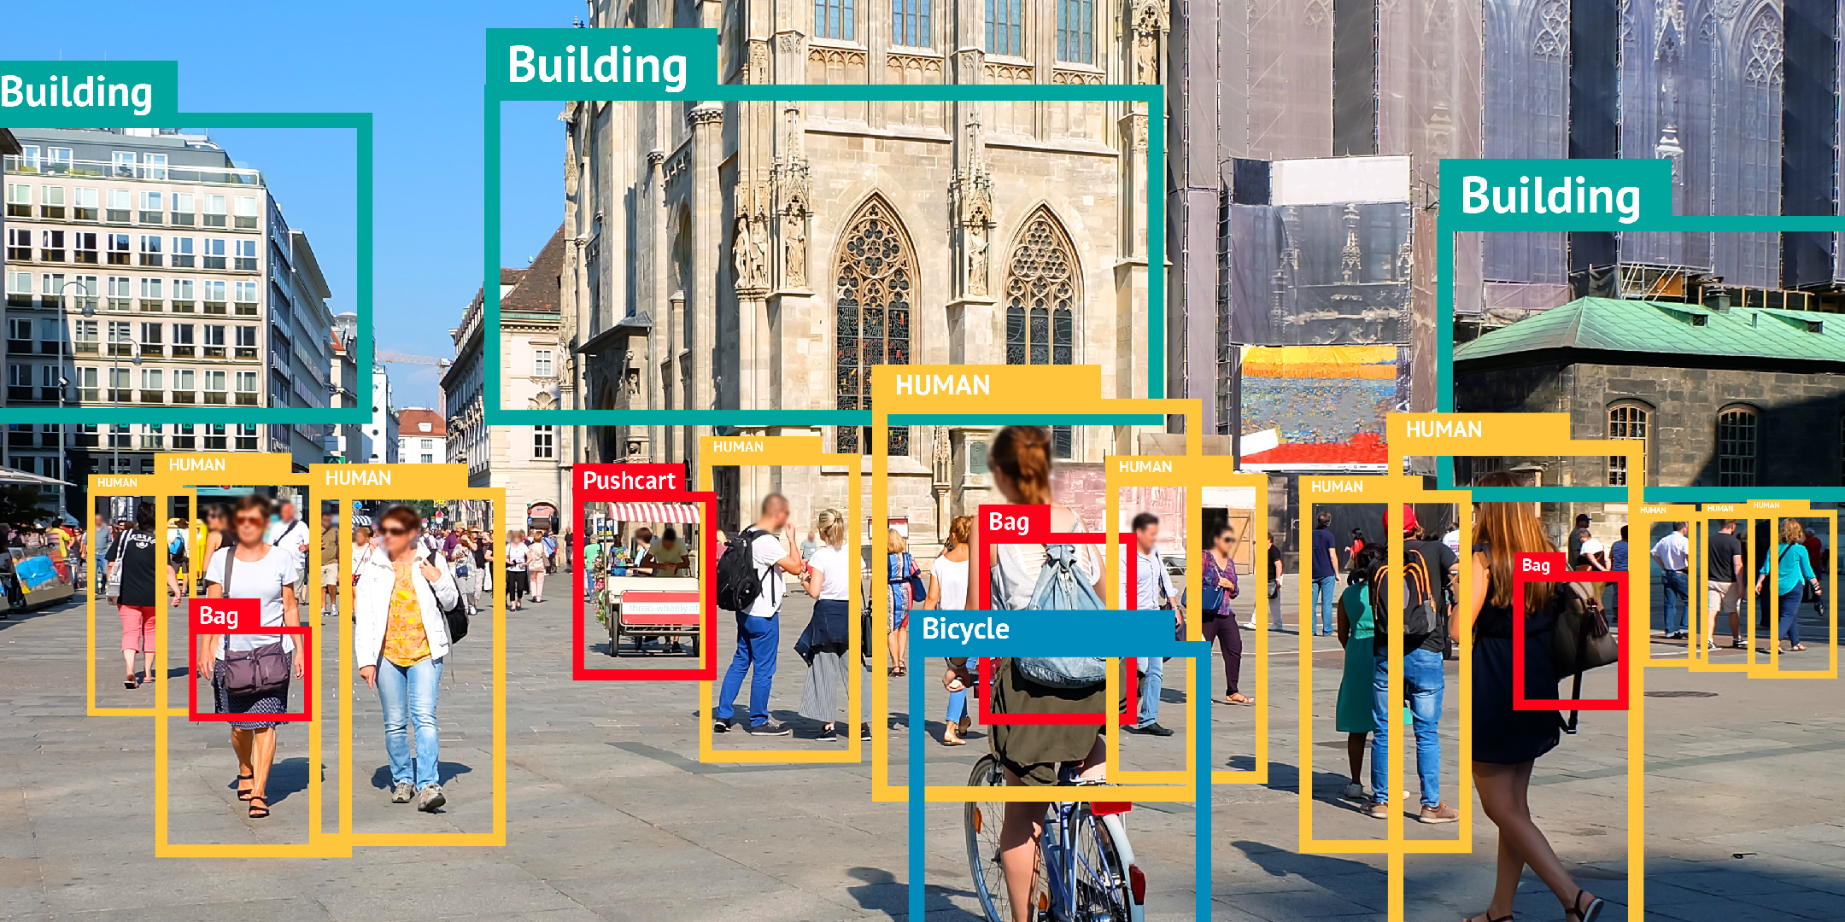
Introduction
Definition: Object detection is a computer vision technique that identifies and locates objects within images or videos, assigning them to predefined categories. ​
Key Components:
Classification: Determining the type or class of an object (e.g., identifying a 'cat' or 'dog’).
​Localization: Pinpointing the object's position, often using bounding boxes to highlight its location.
One-Stage Object Detectors: These models perform object localization and classification in a single pass, directly predicting bounding boxes and class labels from input images. This approach emphasizes speed, making it suitable for real-time application.​
Two-Stage Object Detectors: These models first generate region proposals to identify potential object locations and then classify each proposed region and refine its bounding box. This sequential process often results in higher accuracy but at the cost of increased computational complexity

Slide 3
Custom Training for YOLOv8 Model
Steps for Custom Training
Prepare Dataset:
Collect and annotate images (e.g., using tools like LabelImg or CVAT).
Organize data into train/validation/test sets.
Configure YOLOv8:
Choose a pre-trained model (e.g., YOLOv8n, YOLOv8s).
Modify the configuration file for custom classes.
Train the Model:
Run training script with custom dataset.
Monitor metrics (mAP, precision, recall).
Evaluate and Test:
Validate on test data.
Fine-tune hyperparameters if needed.
Deploy:
Export the model to the desired format (ONNX, TensorRT, etc.).
Integrate into applications.
Start
Prepare Dataset
Configure Yolo
Train the Model
Evaluate
Export Model
Deploy
End

Slide 4
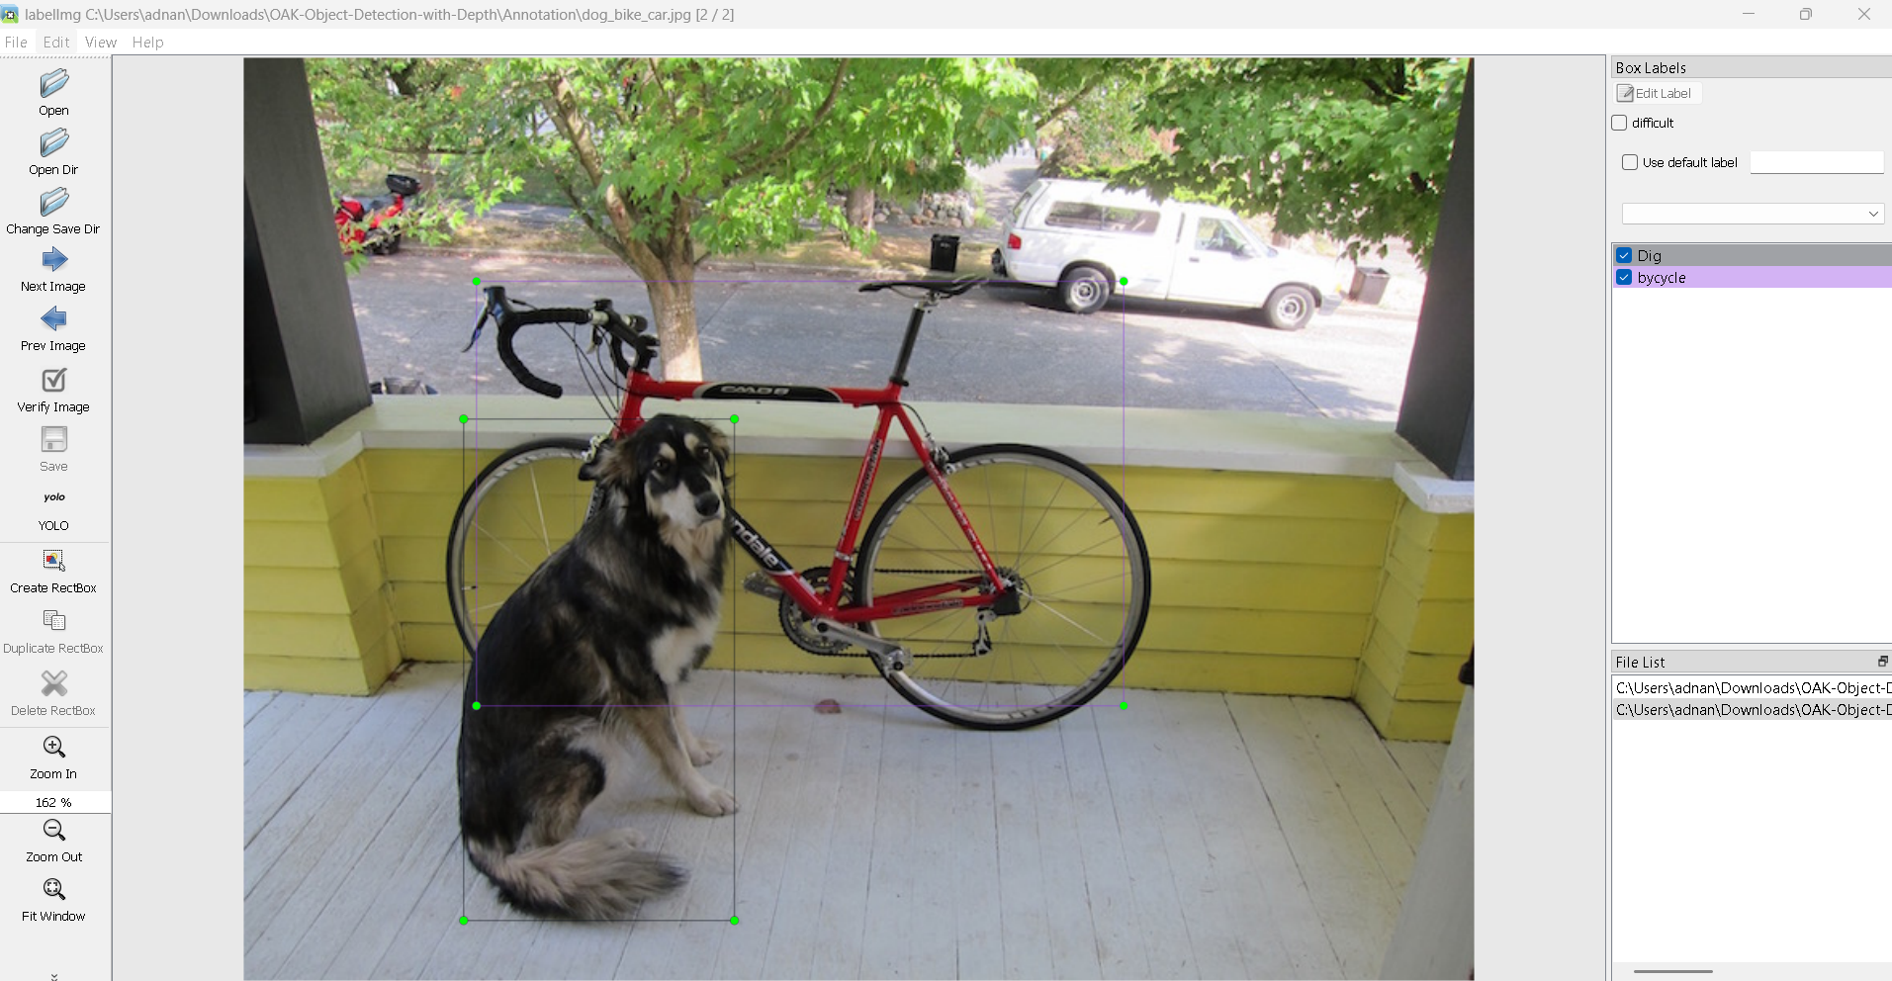
Custom Training for YOLOv8 Model
Steps for Custom Training
Prepare Dataset:
Collect and annotate images (e.g., using tools like LabelImg or CVAT).
Make a separate environment with python 3.10
pip install labelImg
https://pypi.org/project/labelImg/
Start
Prepare Dataset
Class Id (index of class starting from 0)
x_center, y_center, width, height: Normalized values between 0 and 1

Slide 5
Custom Training for YOLOv8 Model
Steps for Custom Training
Configure YOLOv8:
Choose a pre-trained model (e.g., YOLOv8n, YOLOv8s).
Modify the configuration file for custom classes.
Start
Prepare Dataset
Configure Yolo

Slide 6
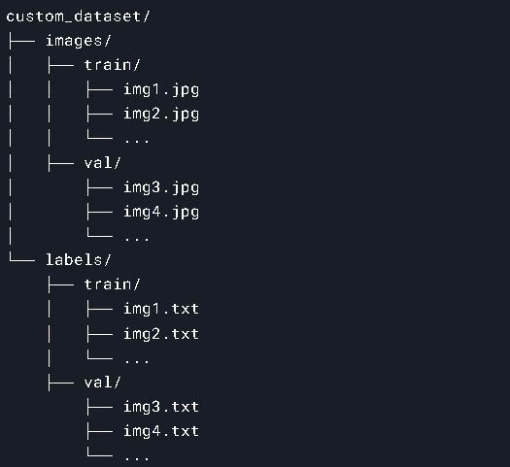
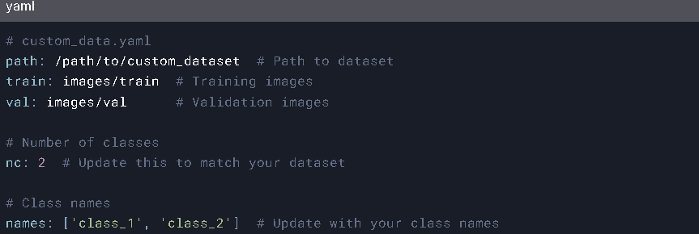
Custom Training for YOLOv8 Model
Steps for Custom Training
Train the Model:
Dataset Folder
Start
Prepare Dataset
Configure Yolo
Train the Model
Yaml file (Create a .yaml file to define your dataset and model configuration)

Slide 7
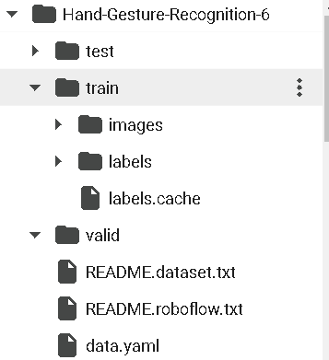
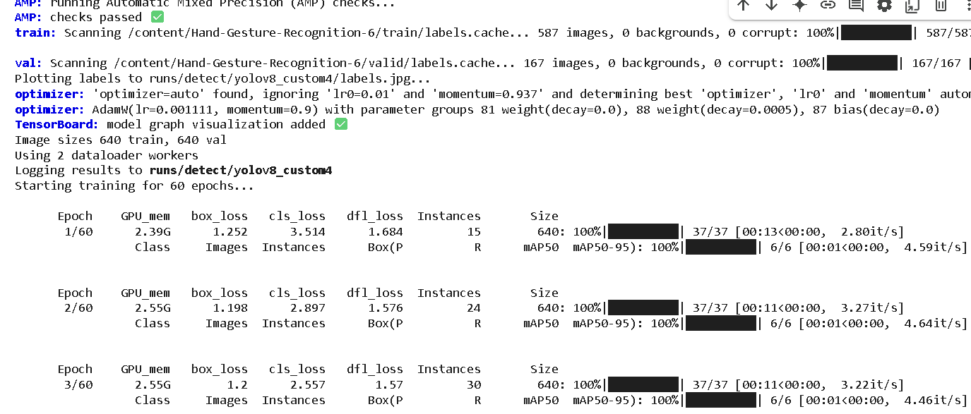
Custom Training for YOLOv8 Model
Steps for Custom Training
Train the Model:
Lets Move to the Colab toturial
After training the weights file w
Start
Prepare Dataset
Configure Yolo
Train the Model

Slide 8
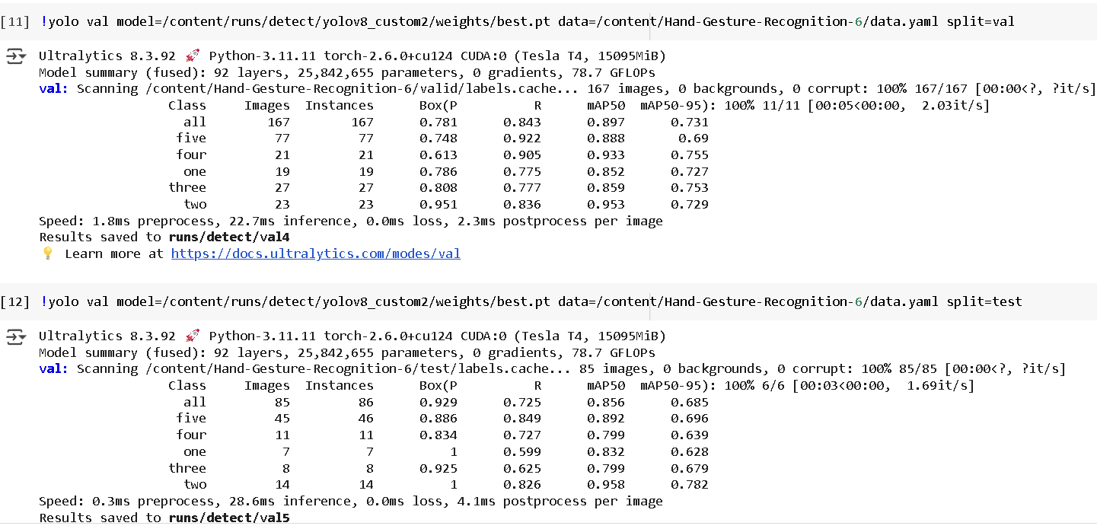
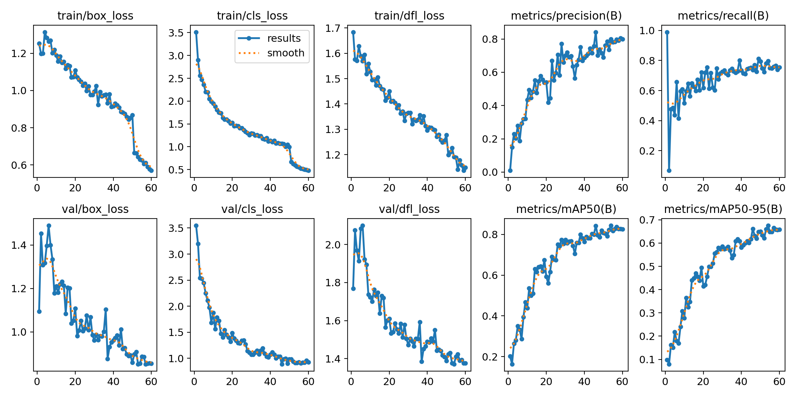
Custom Training for YOLOv8 Model
Steps for Custom Training
Evaluate the Model:
Evaluation on Test and Validation set
Start
Prepare Dataset
Configure Yolo
Train the Model
Evaluate

Slide 9
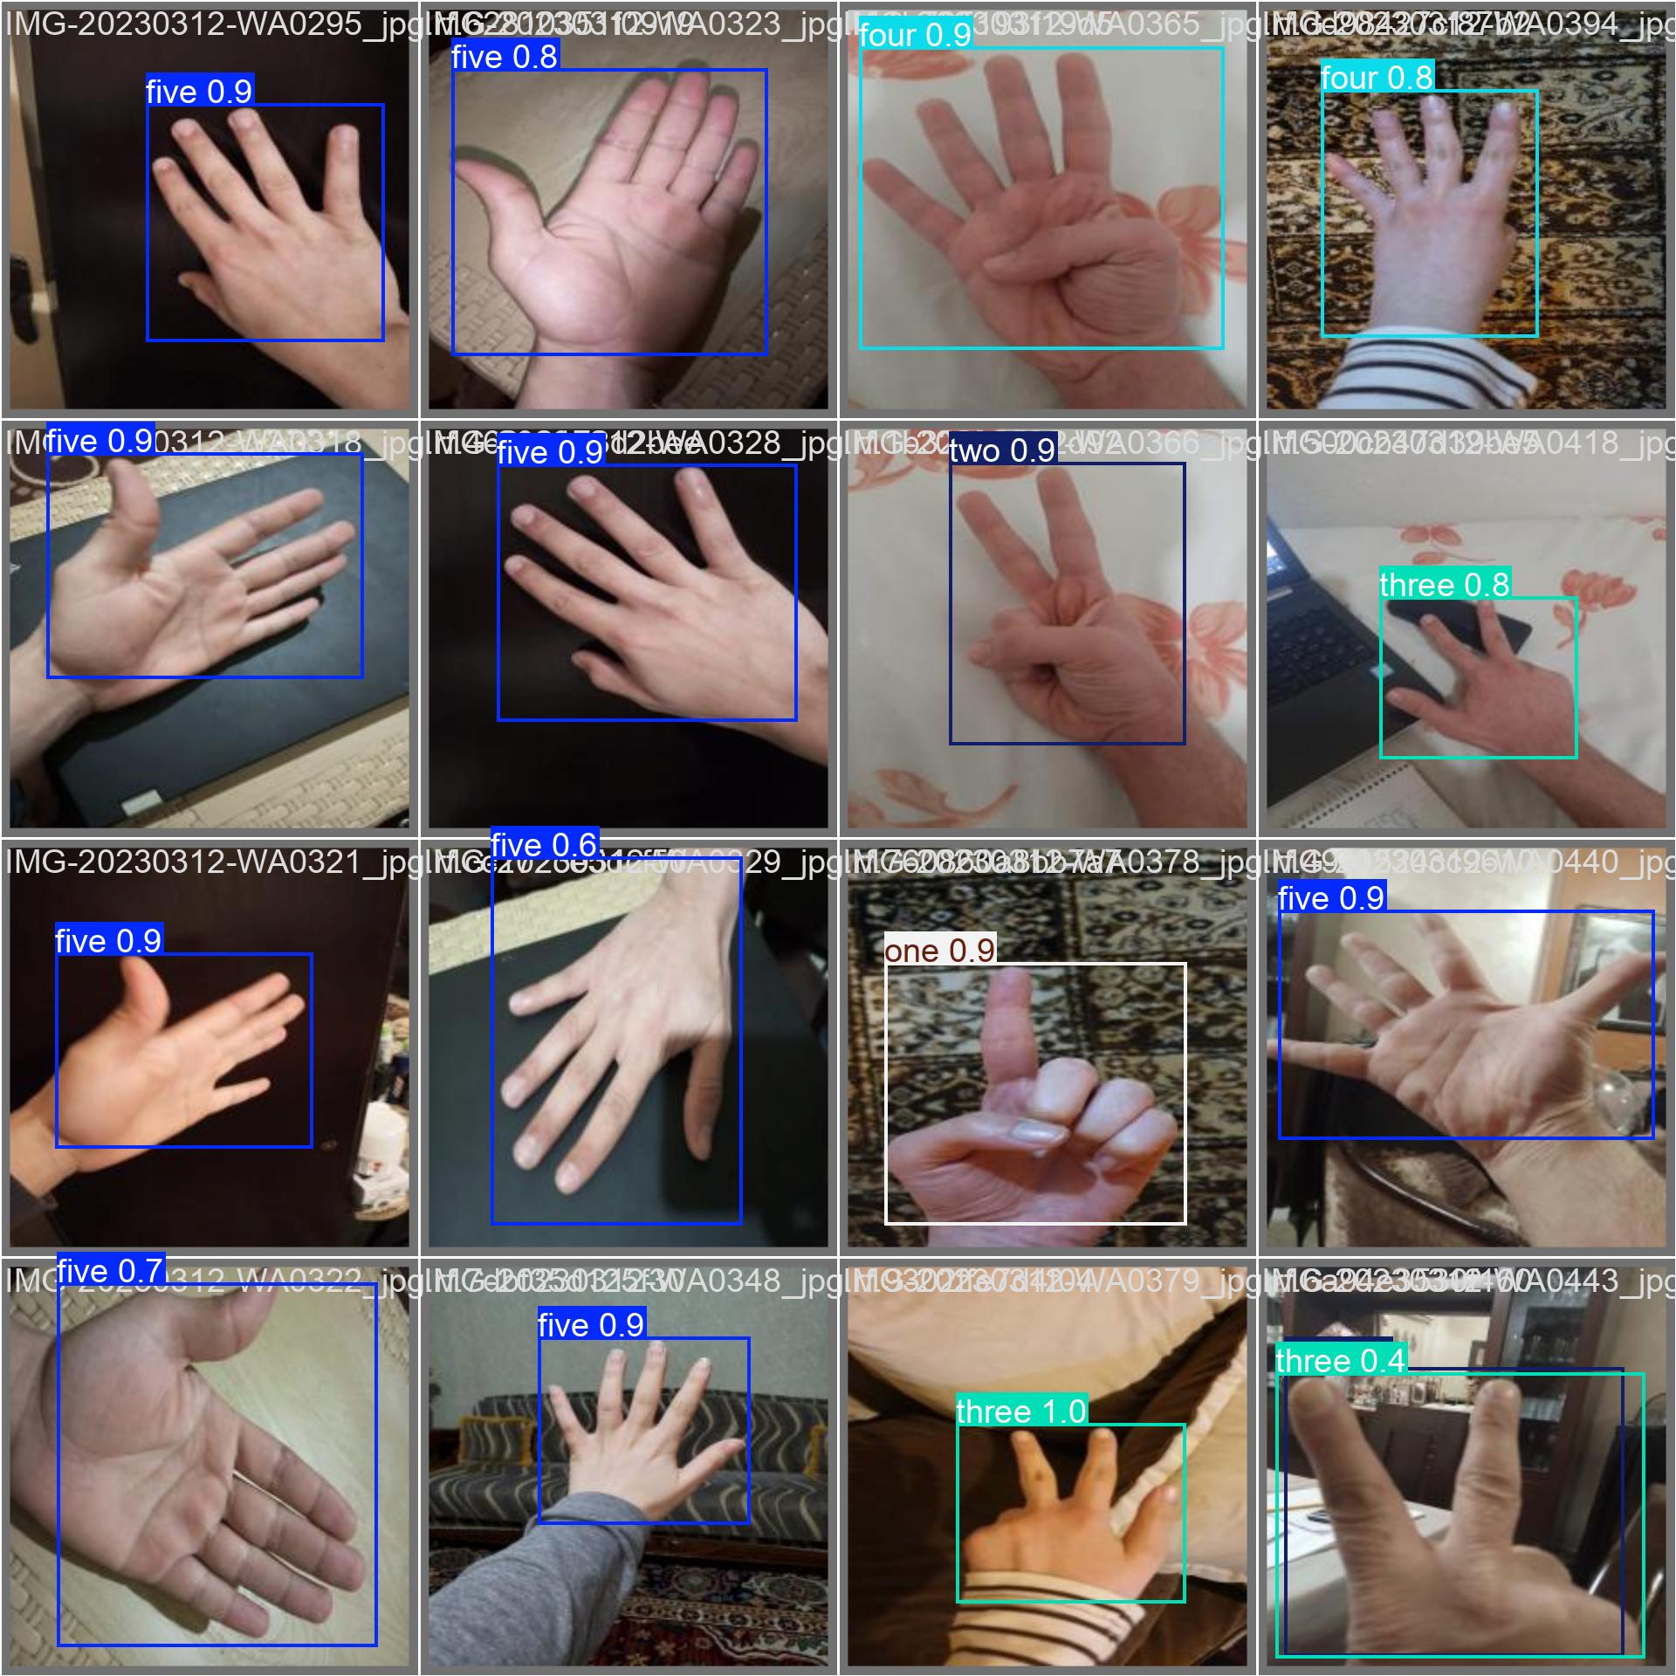
Custom Training for YOLOv8 Model
Steps for Custom Training
Evaluate the Model:
Evaluation on Test and Validation set
Start
Prepare Dataset
Configure Yolo
Train the Model
Evaluate

Slide 10
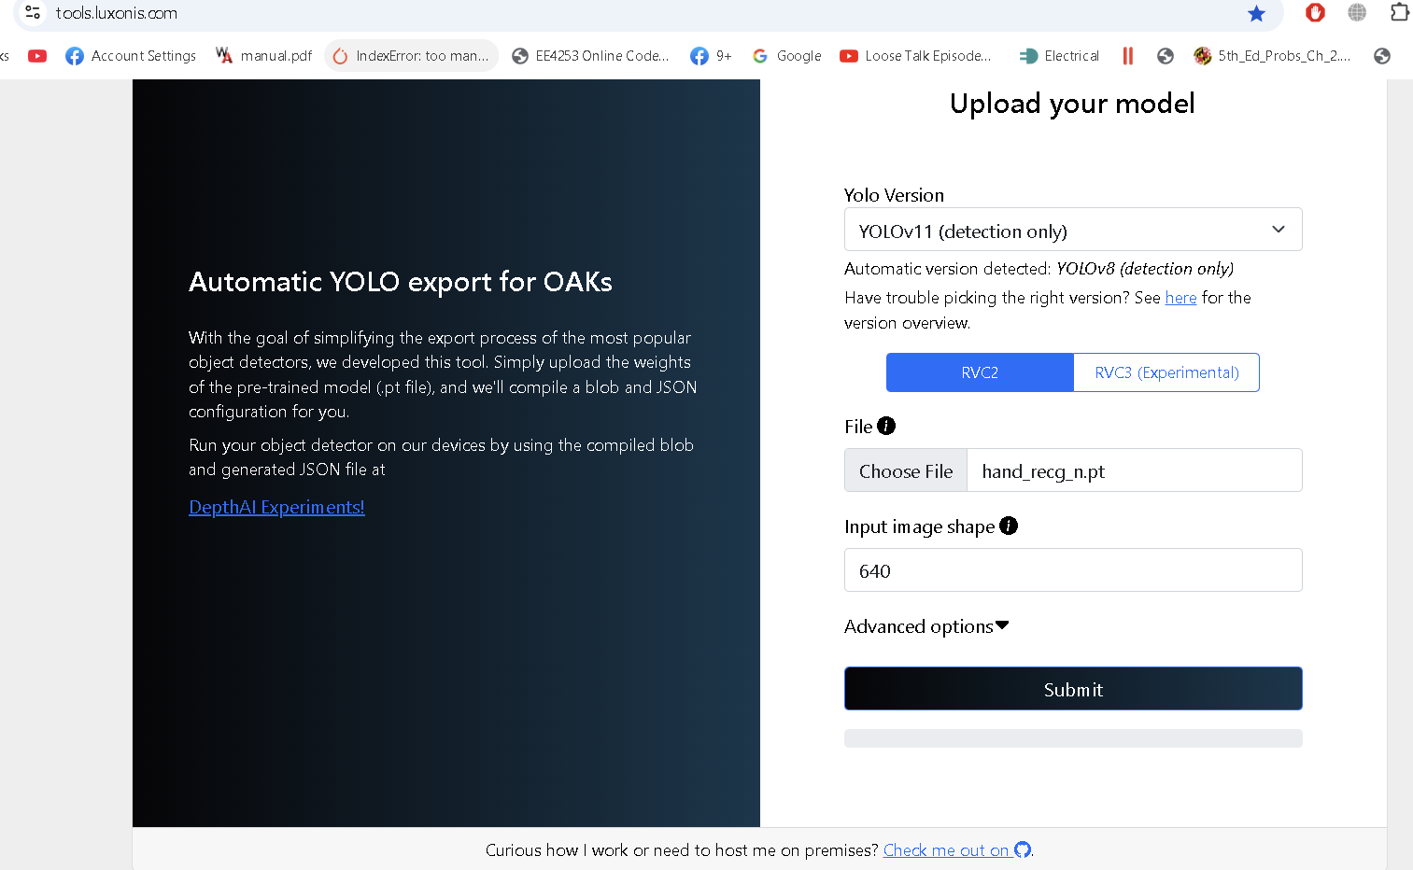
Custom Training for YOLOv8 Model
Steps for Custom Training
Exporting the Model:
Once, the best.pt of trained model is achieved.
Using this website we will convert it into Openvino format,
which OAK-D supports
Start
Prepare Dataset
Configure Yolo
Train the Model
Evaluate
Export Model

Slide 11
Custom Training for YOLOv8 Model
Deployment
Pipeline Components
Color Camera: Captures RGB images at 1080p resolution.
Mono Cameras: Capture stereo images for depth estimation.
StereoDepth Node: Computes depth maps aligned with the RGB camera.
YOLOv8 Model: Detects and classifies hand gestures in real-time.
Output Streams:
RGB frames with bounding boxes.
Depth maps for spatial information.
Start
Prepare Dataset
Configure Yolo
Train the Model
Evaluate
Export Model
Deploy

Slide 12
Custom Training for YOLOv8 Model
Deployment
Workflow
Capture Frames:
RGB and depth frames are captured simultaneously
Preprocess:
Frames are resized to match the YOLOv8 input size (640x640).
Inference:
YOLOv8 model processes the frames to detect hand gestures.
Post-process:
Bounding boxes, labels, and depth information are overlaid
on the RGB frame.
Display:
Processed frames and depth maps are displayed in real-time.
Start
Prepare Dataset
Configure Yolo
Train the Model
Evaluate
Export Model
Deploy

Slide 13
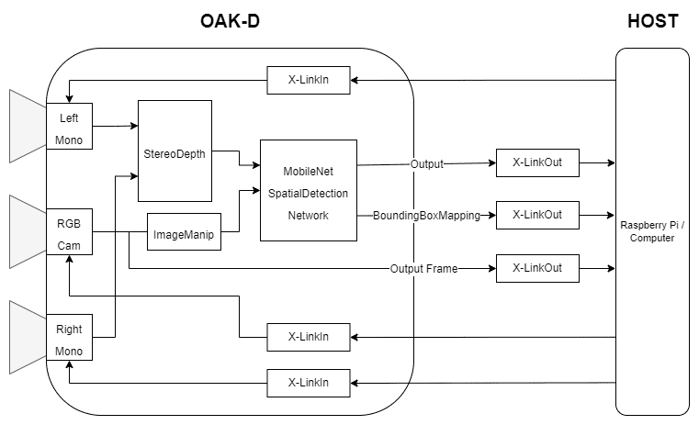
Custom Training for YOLOv8 Model
Deployment
Start
Prepare Dataset
Configure Yolo
Train the Model
Evaluate
Export Model
Deploy
Good Tutorial to Follow

Slide 14
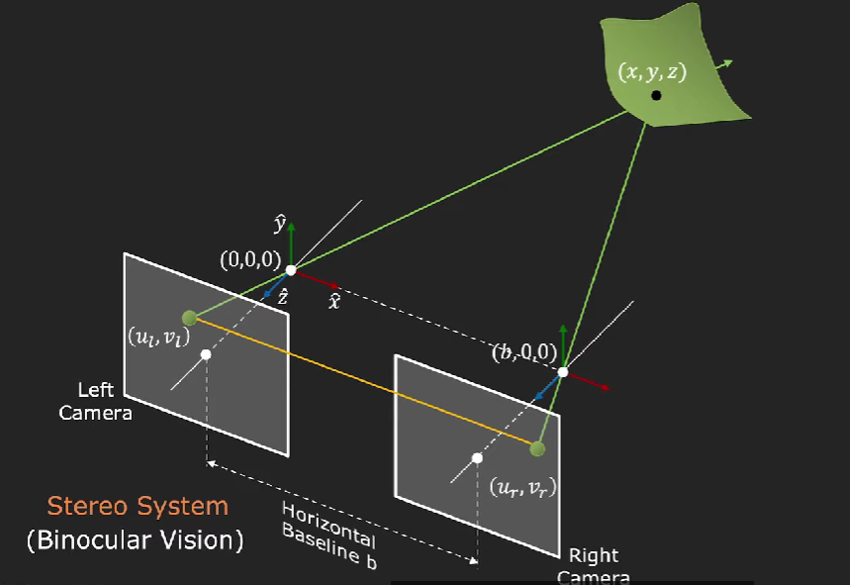
Custom Training for YOLOv8 Model
Deployment
Start
Prepare Dataset
Configure Yolo
Train the Model
Evaluate
Export Model
Deploy
Good Tutorial to Follow

Slide 15
Custom Training for YOLOv8 Model
Deployment
Start
Prepare Dataset
Configure Yolo
Train the Model
Evaluate
Export Model
Deploy
End

Slide 16


g202110550@kfupm.edu.sa

